Slide 1
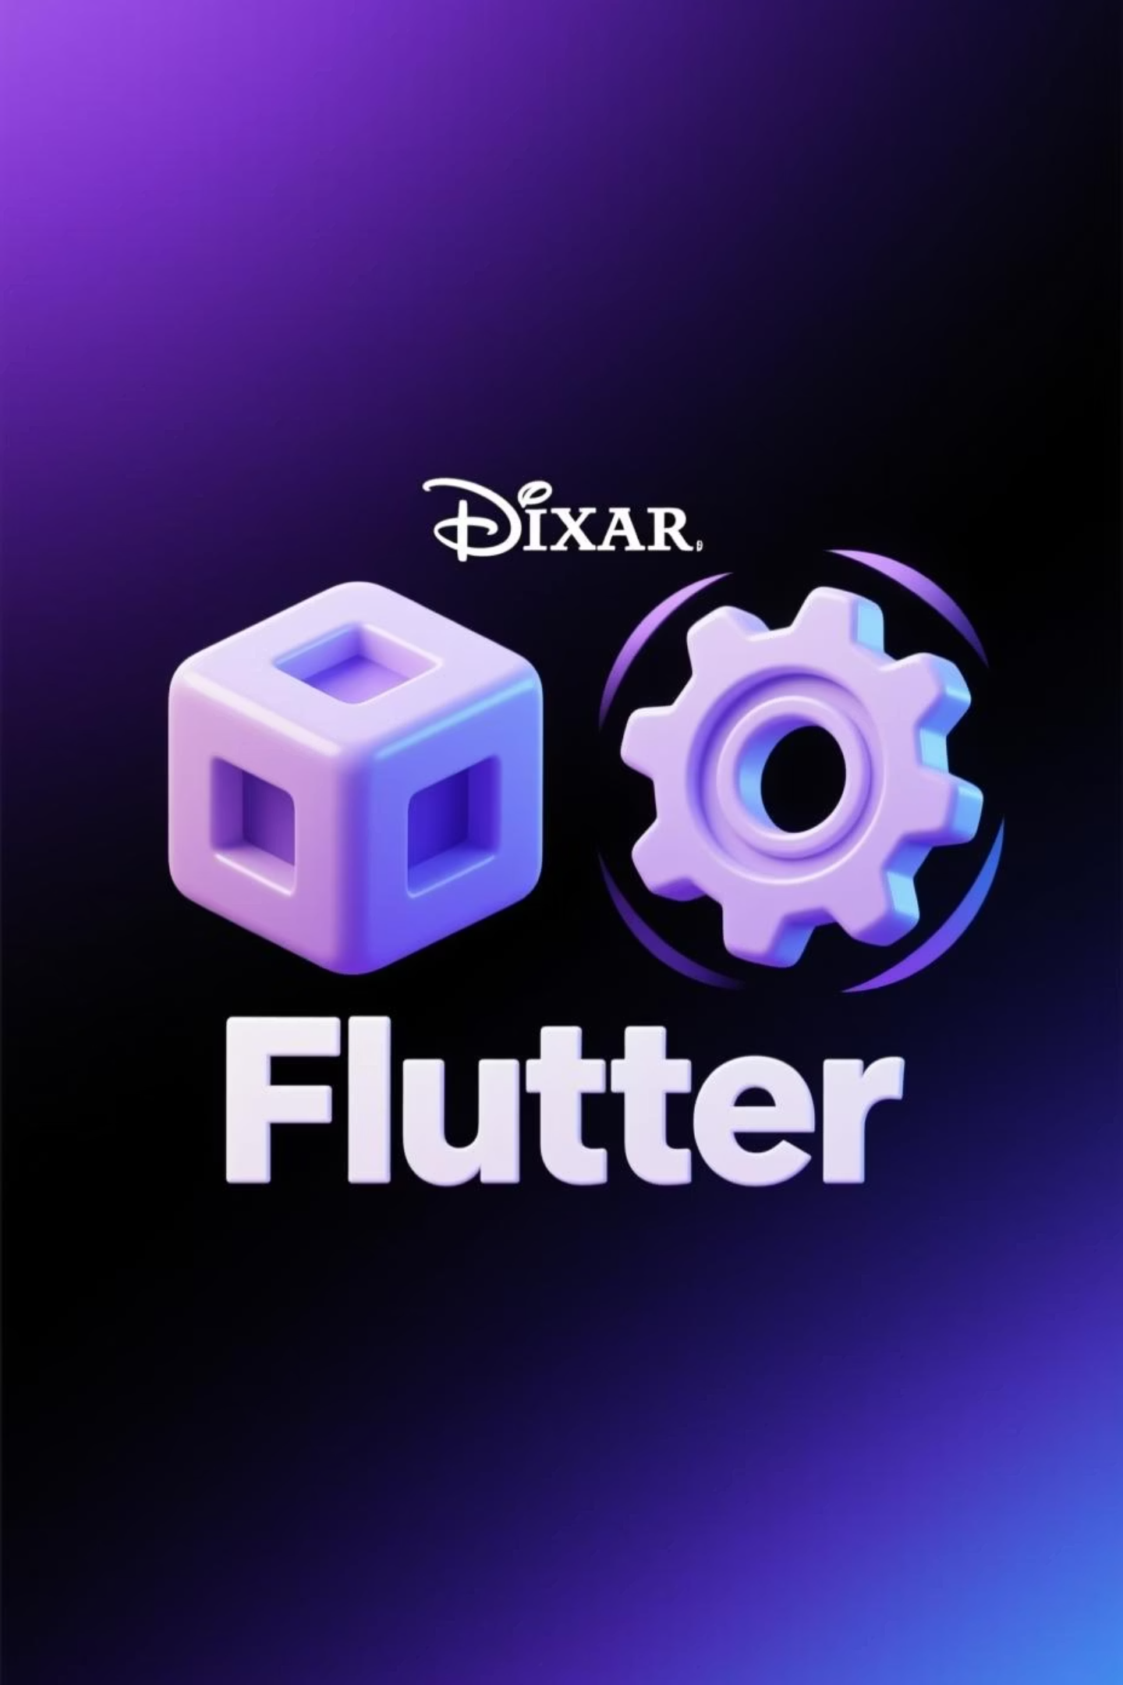
Stateless & Stateful Widgets in Flutter
Understanding Widget Types and When to Use Each

Slide 2


What Are Widgets?
In Flutter, everything is a widget. These widgets are the fundamental building blocks of your user interface, defining every visible element and interaction within your application.
UI Building Blocks
1
Widgets are the modular units that compose your app's visual structure.
2
Two Main Types
Flutter primarily categorizes widgets into two core types: StatelessWidget and StatefulWidget.

Slide 3

Stateless Widget: The Immutable UI
No Internal State
UI Does Not Auto-Refresh
A StatelessWidget does not possess mutable state that changes over time.
Its user interface remains constant and will not rebuild automatically once initialized.
Ideal for Static Content
Input-Dependent
Perfect for elements that display information but don't need to change after being drawn.
Its appearance is solely determined by the data provided during its creation.

Slide 4
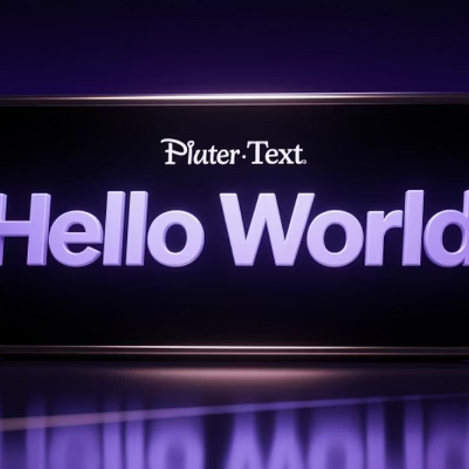

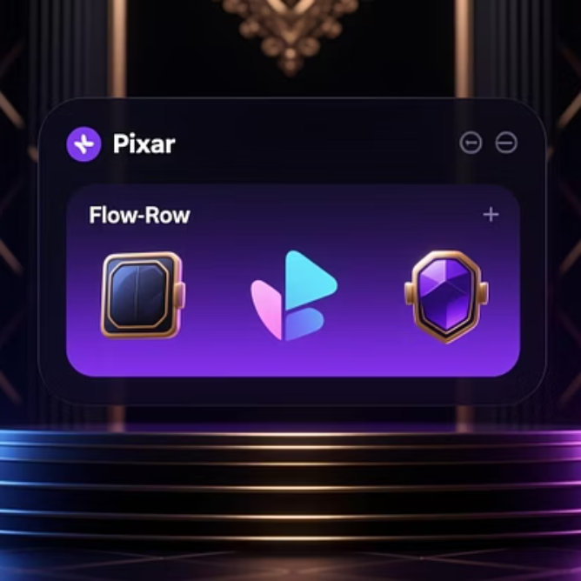


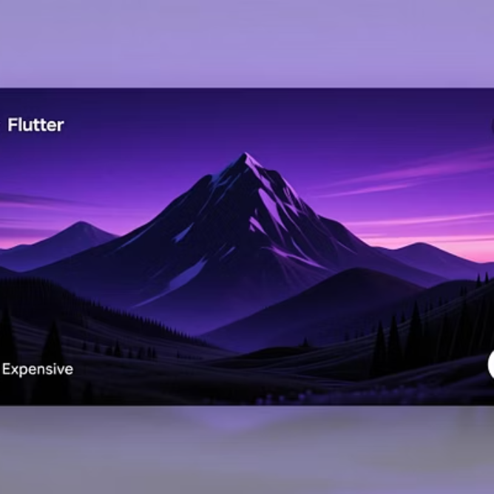
Stateless Widget: Common Examples
These widgets are fundamental for building static components within your Flutter applications, relying purely on their initial configuration.

Slide 5
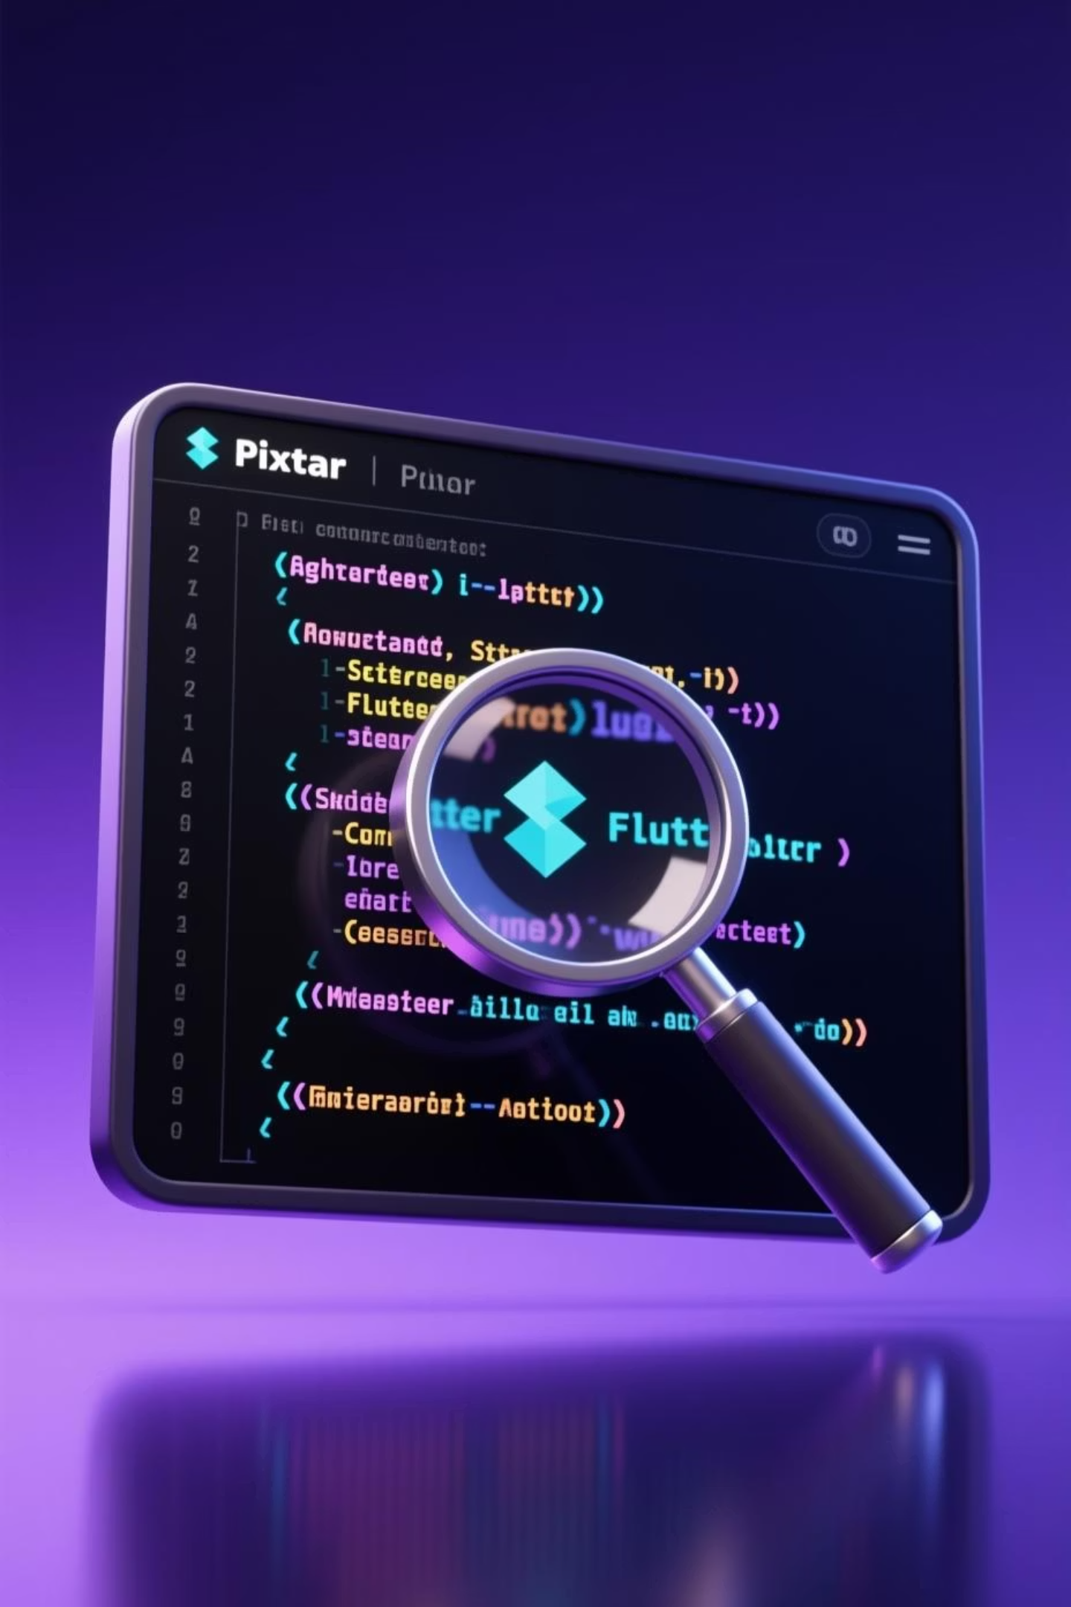
StatelessWidget Code Example
This simple code illustrates a StatelessWidget that displays a greeting. Once built, the text "Hello Students!" will not change.
class MyTitle extends StatelessWidget { @override Widget build(BuildContext context) { return Text("Hello Students!"); } }

Slide 6


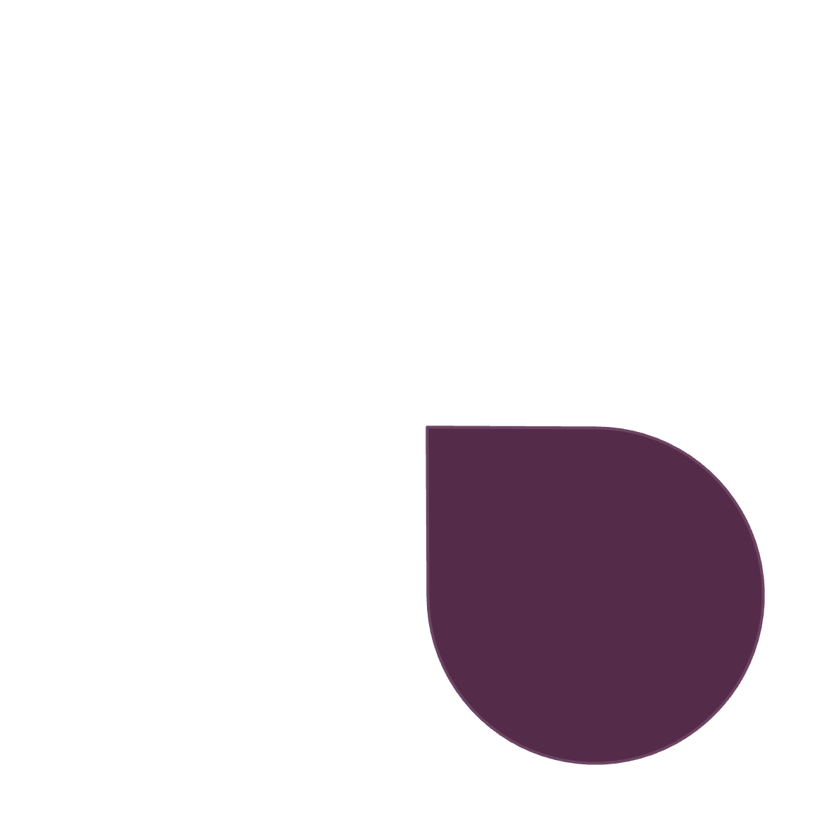
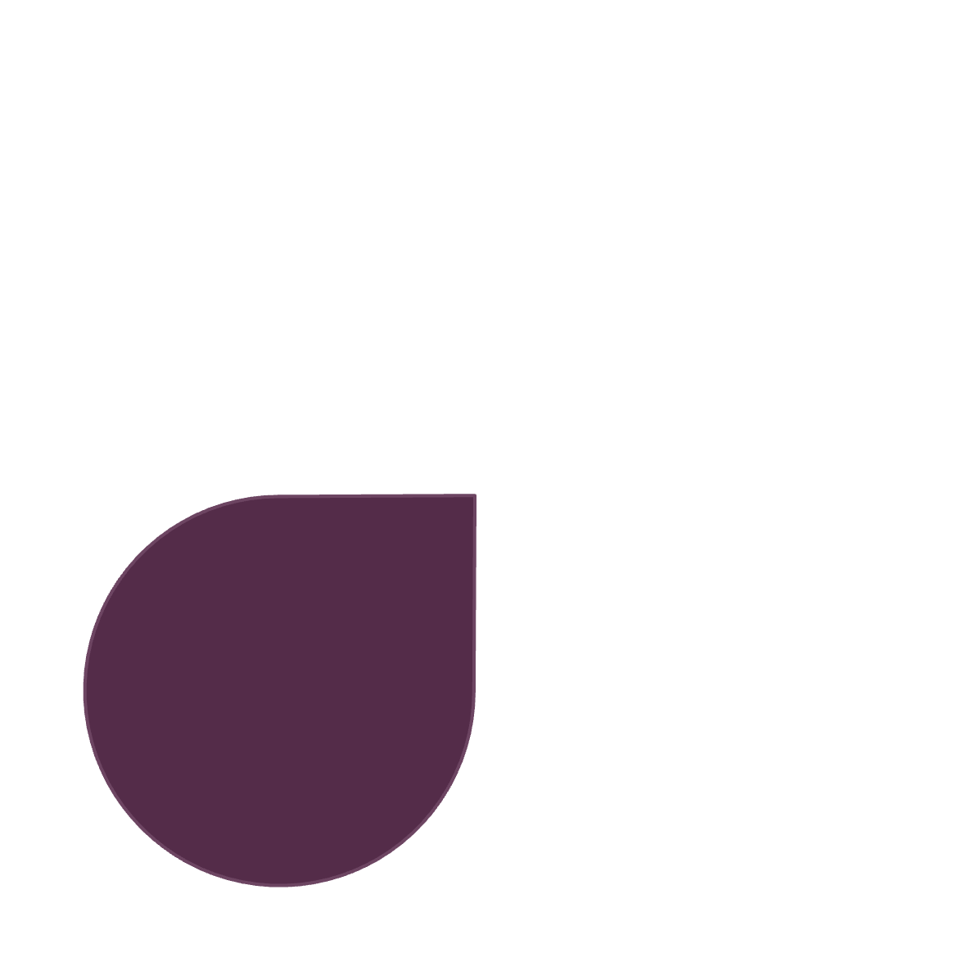

Stateful Widget: Dynamic Interactions
Changes Over Time
UI Updates with setState()
A StatefulWidget can inherently modify its appearance and behavior during the application's runtime.
To trigger a rebuild of its UI, you must explicitly call the setState() method.
Dynamic Content
User Interaction
Used when managing counters, timers, animations, or data loaded asynchronously.
Essential for elements that respond to user input, such as button presses or form entries.

Slide 7
Stateful Widget: Practical Applications
Stateful Widgets are crucial for creating interactive and responsive user experiences in Flutter.
TextField
Checkbox / Switch
Counter App
API Loading Data
Allows users to input and edit text dynamically.
Toggles boolean states based on user interaction.
Demonstrates state changes through incremental values.
Displays different states while fetching data from a server.

Slide 8
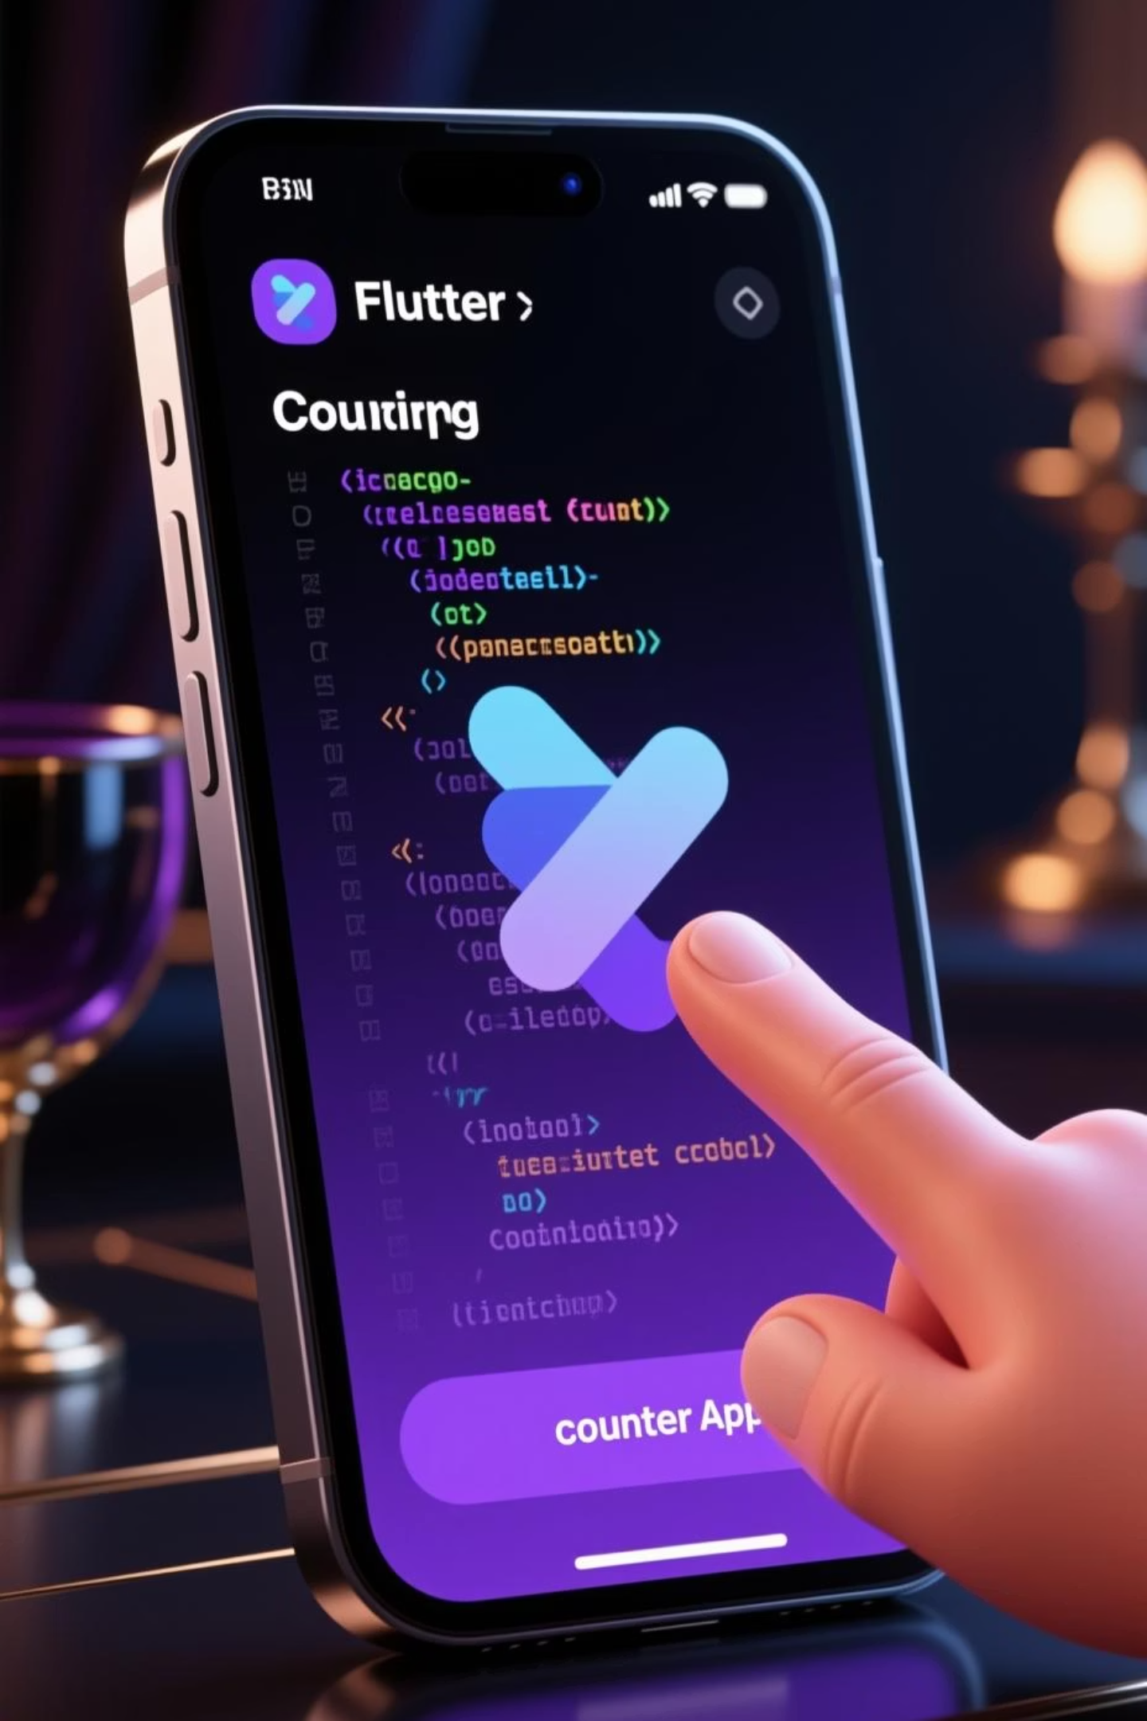
StatefulWidget Code Example
This example demonstrates a simple counter. The setState() call in increase() rebuilds the widget to show the updated count.
class CounterPage extends StatefulWidget { @override _CounterPageState createState() => _CounterPageState(); } class _CounterPageState extends State { int count = 0; void increase() { setState(() => count++); } @override Widget build(BuildContext context) { return Column( children: [ Text("Count: $count"), ElevatedButton(onPressed: increase, child: Text("Add")) ], ); } }

Slide 9
Stateless vs. Stateful: Key Differences
Feature
StatelessWidget
StatefulWidget
UI updates
❌ No automatic refresh
✔ Rebuilds with setState()
Uses internal state
❌ No
✔ Yes, mutable state
Complexity
Simple, performant
More complex, state management
Best for
Static display, fixed content
Interactive elements, dynamic data

Slide 10
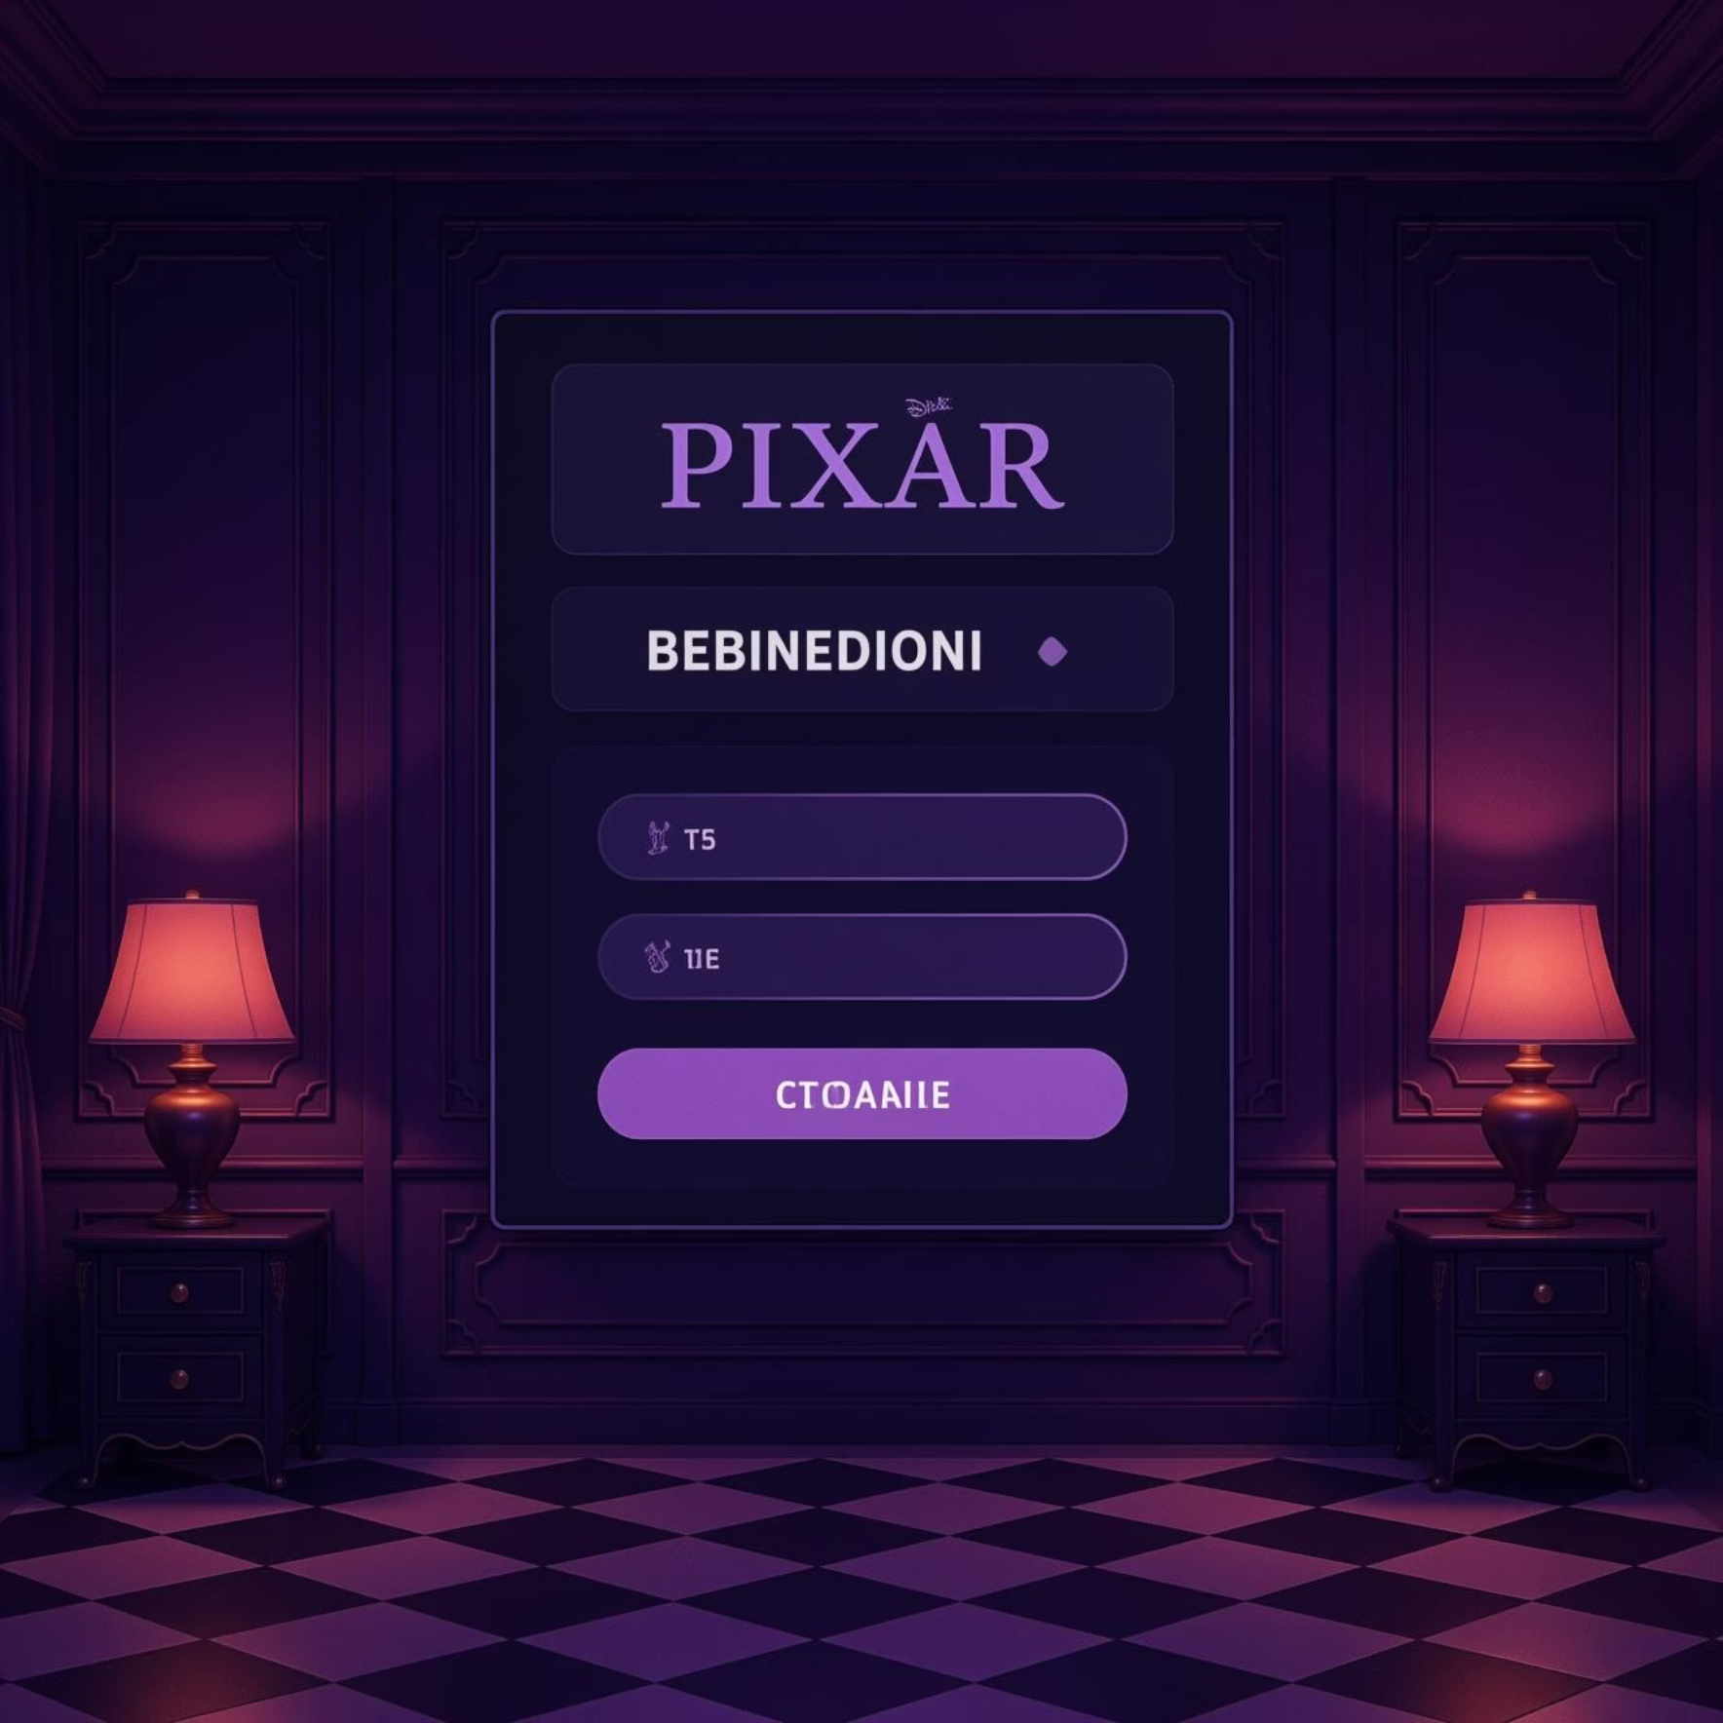
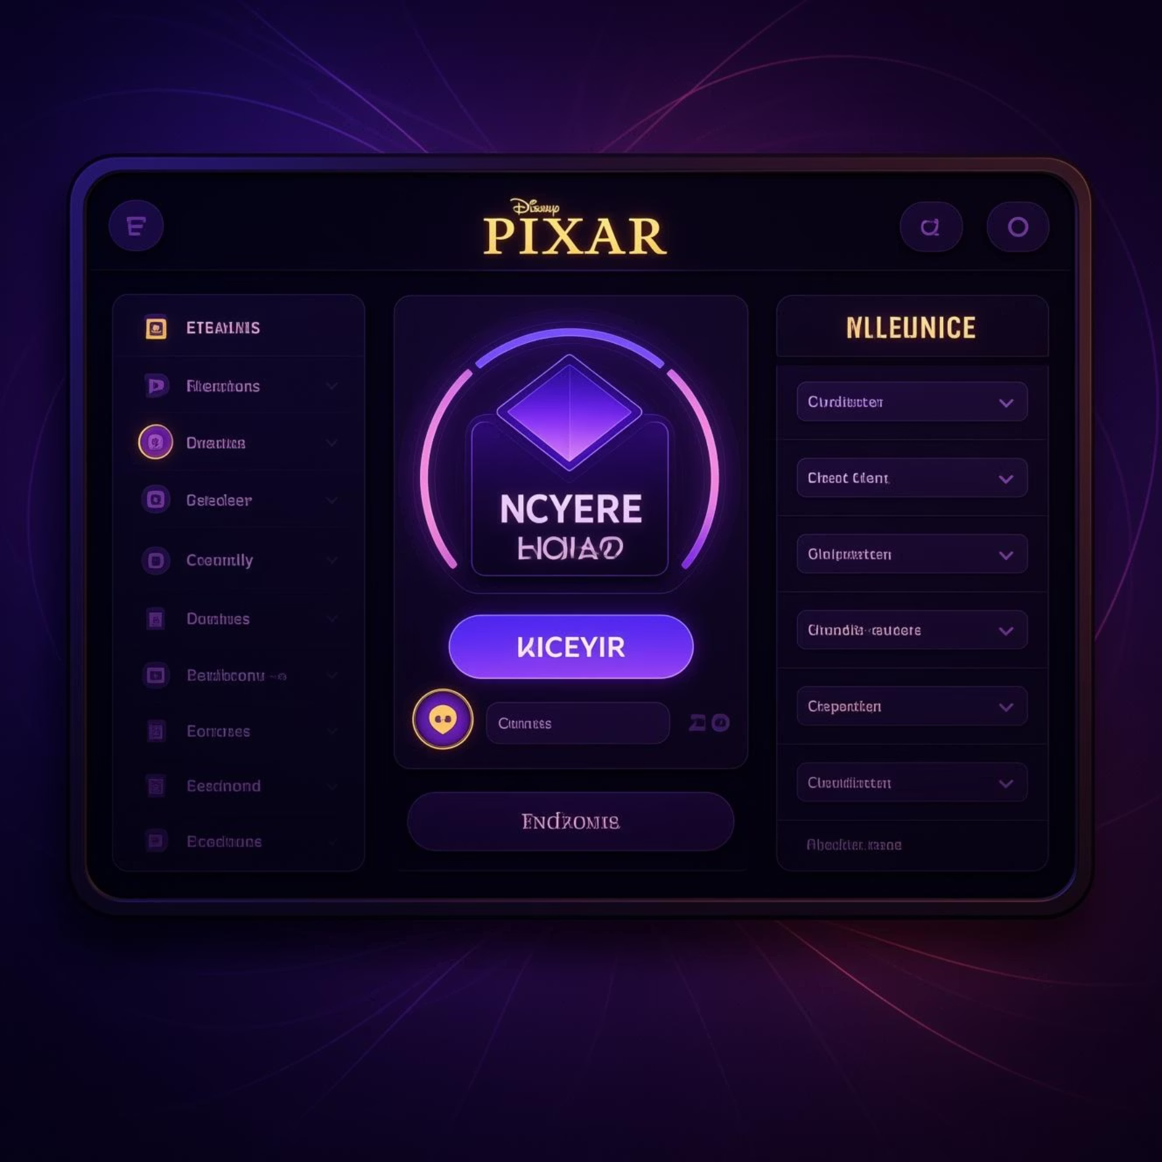
When to Use Each Widget Type
Use StatelessWidget when:
Use StatefulWidget when:
The UI will never change after it's drawn.
The UI needs to change on user interaction (e.g., click).
The widget only displays data passed to it.
You have a timer, counter, or animation that updates.
It's purely presentational and reacts to no events.
There are form inputs where user data changes the UI.
The widget displays different states during API loading.

